Slide 1
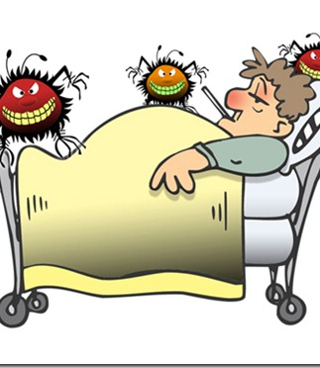
This presentation is about
Diabetes
By Dallie Shell
This Photo by Unknown Author is licensed under CC BY-SA-NC

Slide 2

What is diabetes?
It is a
This Photo by Unknown Author is licensed under CC BY-SA

Slide 3

Who is at risk of developing diabetes
People who do not practice healthy eating habits.
Individuals who are middle to old age.
Women during pregnancy.

Slide 4
Common types of diabetes
Type 1 Diabetes
Type 2 Diabetes
Gestational Diabetes

Slide 5
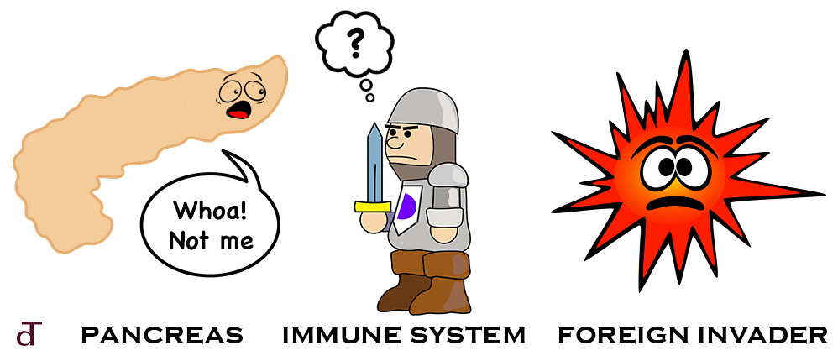
diabetes type 1
Starts when the body stops producing insulin, and the immune system dysfunctions.

Slide 6
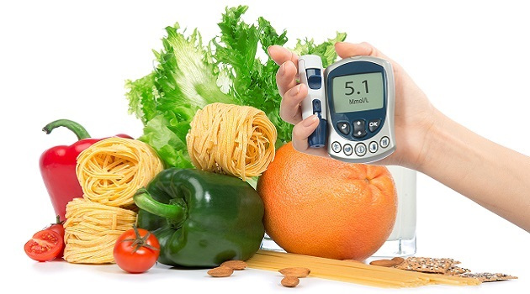
Type 2 diabetes
Starts when the body refuses to use the energy from the food that is consumed.
This Photo by Unknown Author is licensed under CC BY-ND

Slide 7
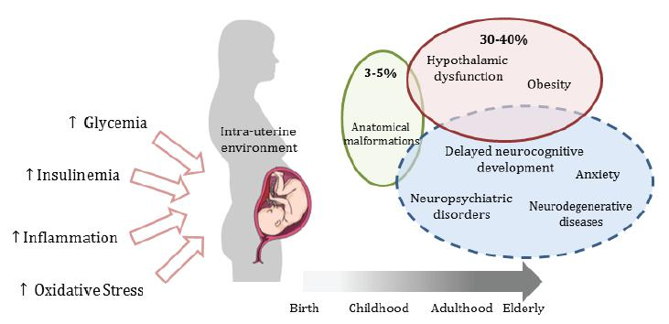
Gestational Diabetes
Develops in women during pregnancy.
It happens when the body do not have enough insulin to support the baby, and the mother to be.
This Photo by Unknown Author is licensed under CC BY

Slide 8
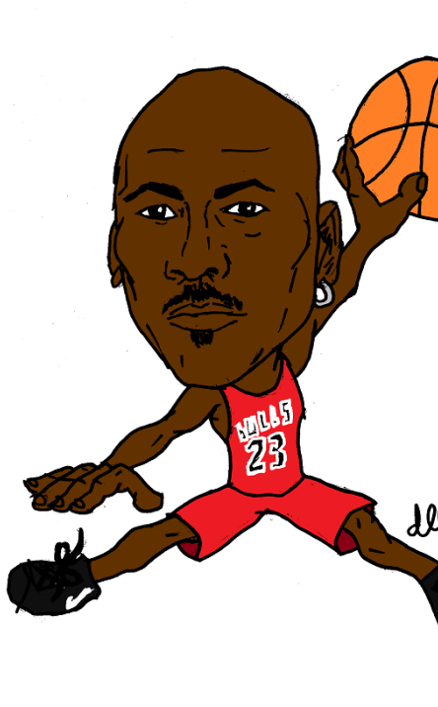
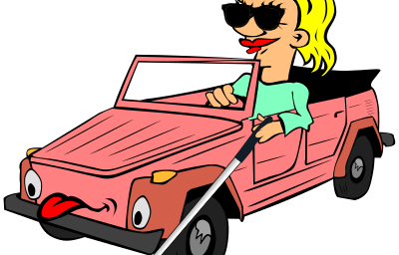
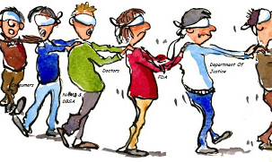
Diabetes stops people from
Being able to see clearly.
Operating a motor vehicle without help.
Playing sports
Being able to eat lots of candy.
This Photo by Unknown Author is licensed under CC BY-NC-ND

Slide 9

Coping with diabetes
Eat healthy foods, like vegetables, fruits, and nuts.
Exercise regularly
Closely monitor your blood sugar level.
Keep close contact with your primary physician
This Photo by Unknown Author is licensed under CC BY

Slide 10
References
References
https://www.diabetes.org/diabetes
https://www.cdc.gov/diabetes/basics/diabetes.html
.https://permanent.fdlp.gov/gpo64739/Causes_of_Diabetes_508.pdf
https://www.diabetes.org/diabetes/gestational-diabetes
https://permanent.fdlp.gov/gpo64739/Causes_of_Diabetes_508.pdf
https://www.cdc.gov/diabetes/data/statistics-report/diagnosed-undiagnosed-diabetes.html

Slide 11
Reference Cont.
https://www.aihw.gov.au/getmedia/c839baba-3180-4a0e-bbbf-1b68986ac26e/14593.pdf.aspx?inline=true
Kalra, S., Jena, B. N., & Yeravdekar, R. (2018). Emotional and Psychological Needs of People with Diabetes. Indian journal of endocrinology and metabolism, 22(5), 696–704. https://doi.org/10.4103/ijem.IJEM_579_17
https://archive.childrenwithdiabetes.com/support/us-nj.htm
https://defeatdiabetes.org/get-healthy/diabetes-support-groups-states-n-u/

