Slide 1

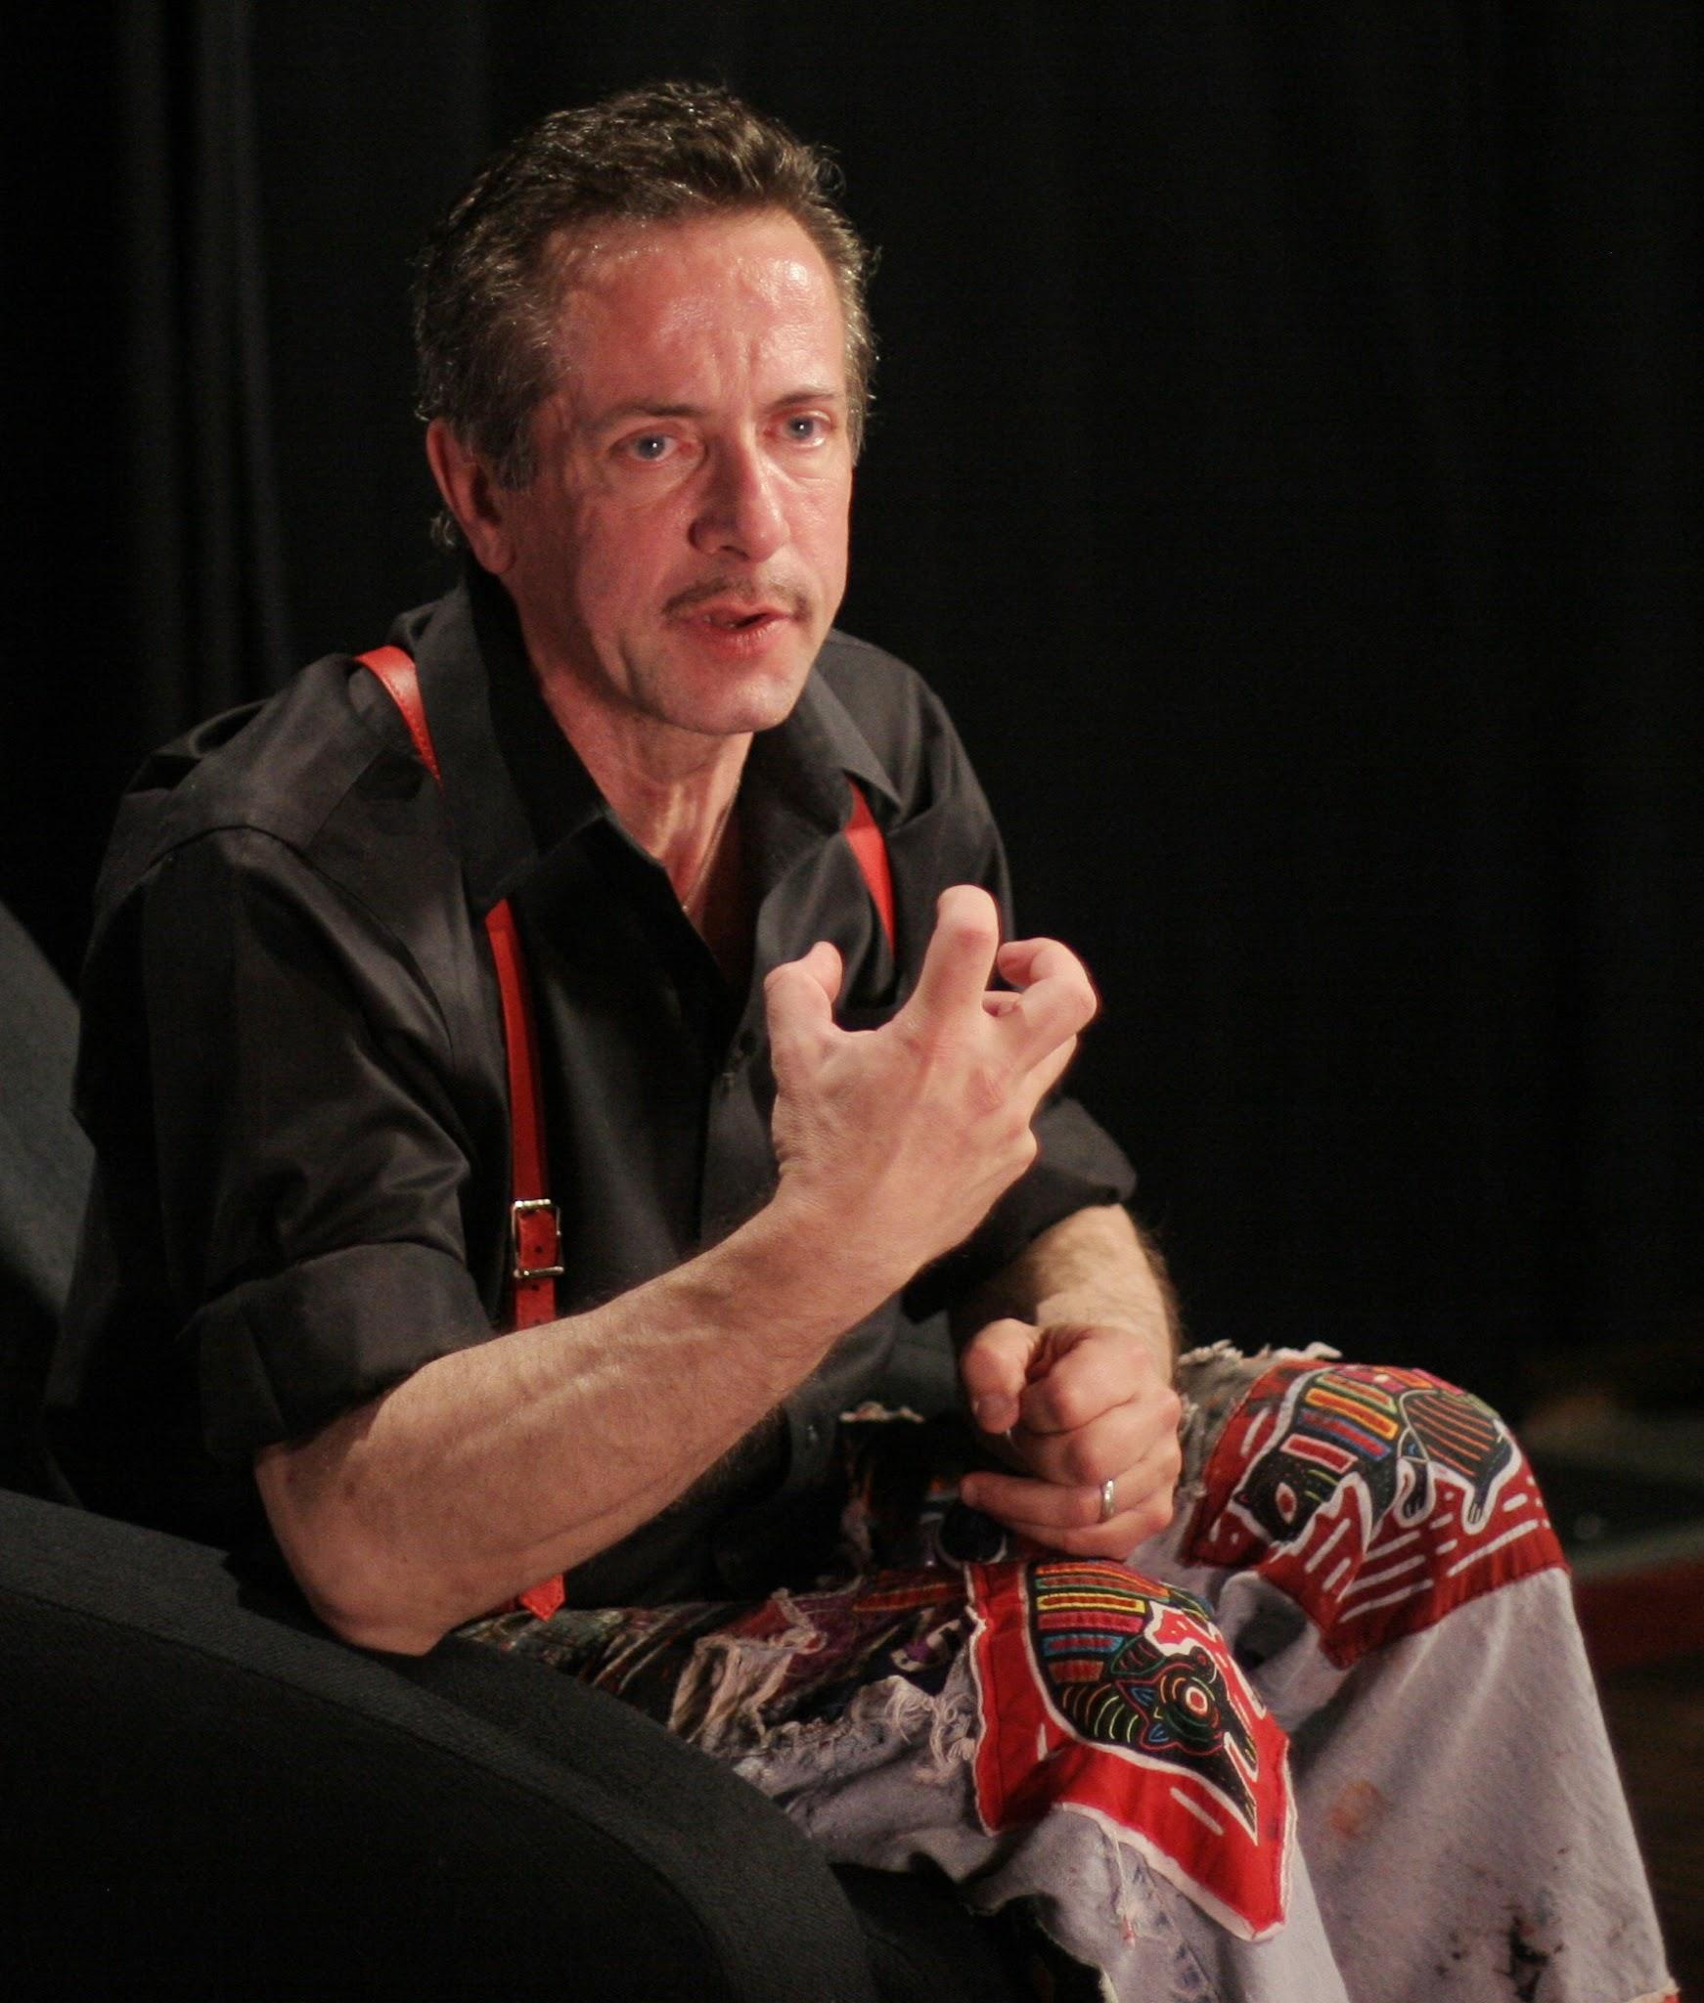
Author Spotlight
Clive Barker

Slide 2
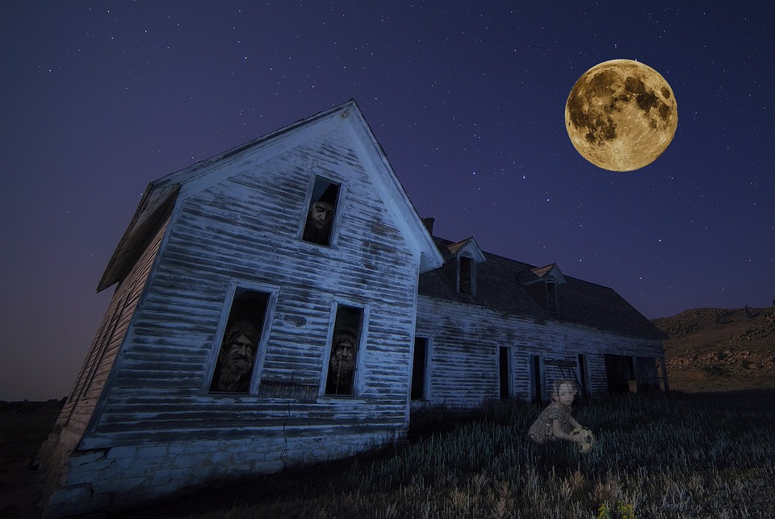
This presentation was created to enlighten you about
Clive Barker
By Providing you with an overview of his life.
Expounding on his works, and writing styles.
Discussing the major contributions he made.
Engaging the class in a discussion to unpack the short story titled “The Yattering and Jack”!

Slide 3
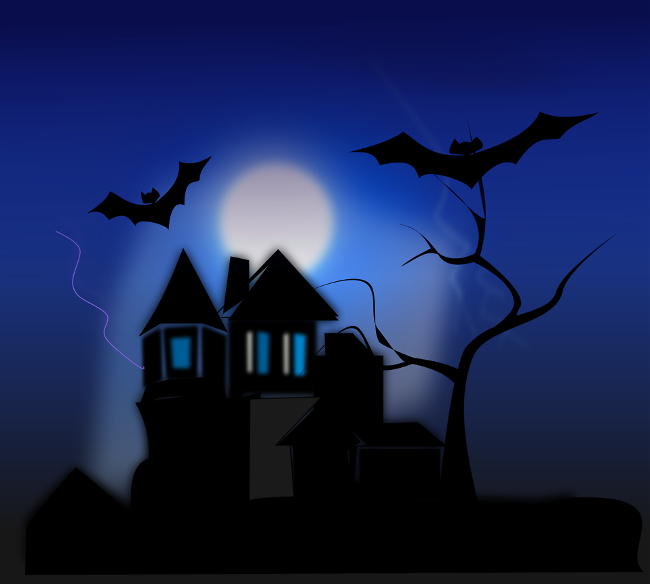
Family Overview
His biological name is Clive Barker, and he was born on October 5, 1952 in Liverpool, Merseyside.
He was the only child and son that was born to his parents.
Mothers name is Joan Ruby, and she was lively storyteller.
Father name is Leonard Barker, and he was a shipping clerk

Slide 4
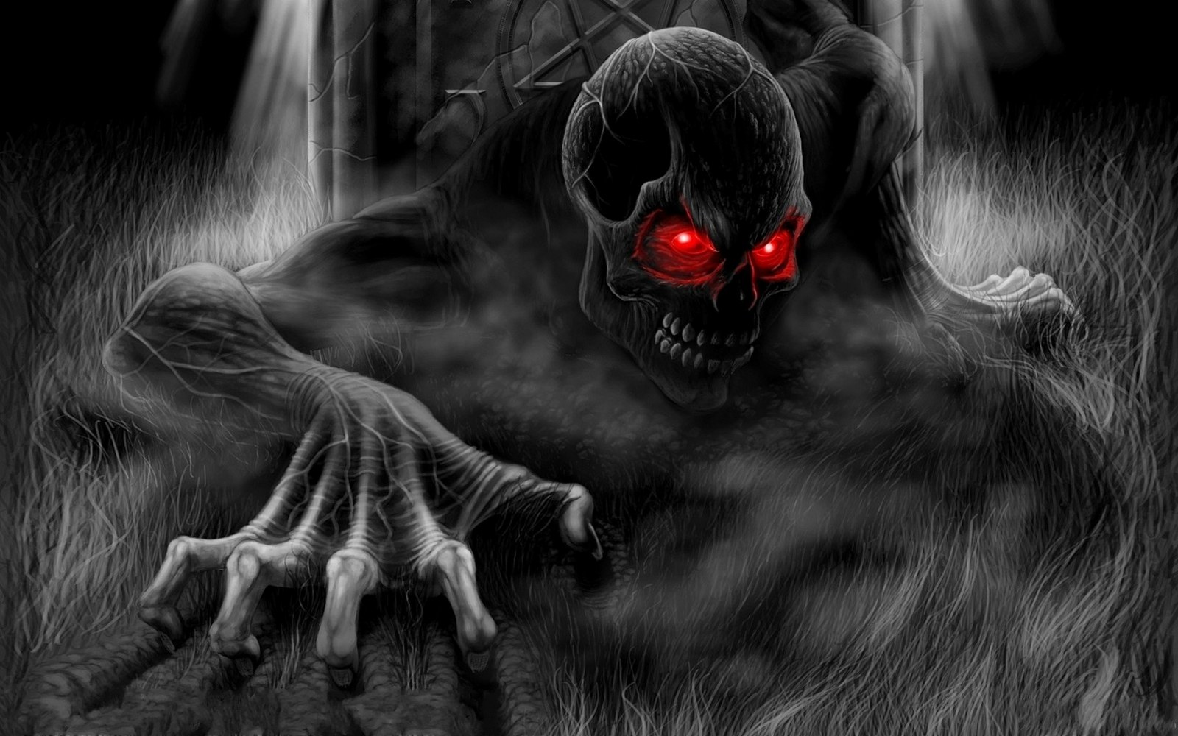
The love of his life
Clive barker met his partner, fashion photographer David Armstrong, in 1996, and the two fell in love.
The couple held a marriage ceremony in 1997.
Through this union, Barker has a stepdaughter named Nicole, who was armstrongs daughter from a previous marriage.

Slide 5
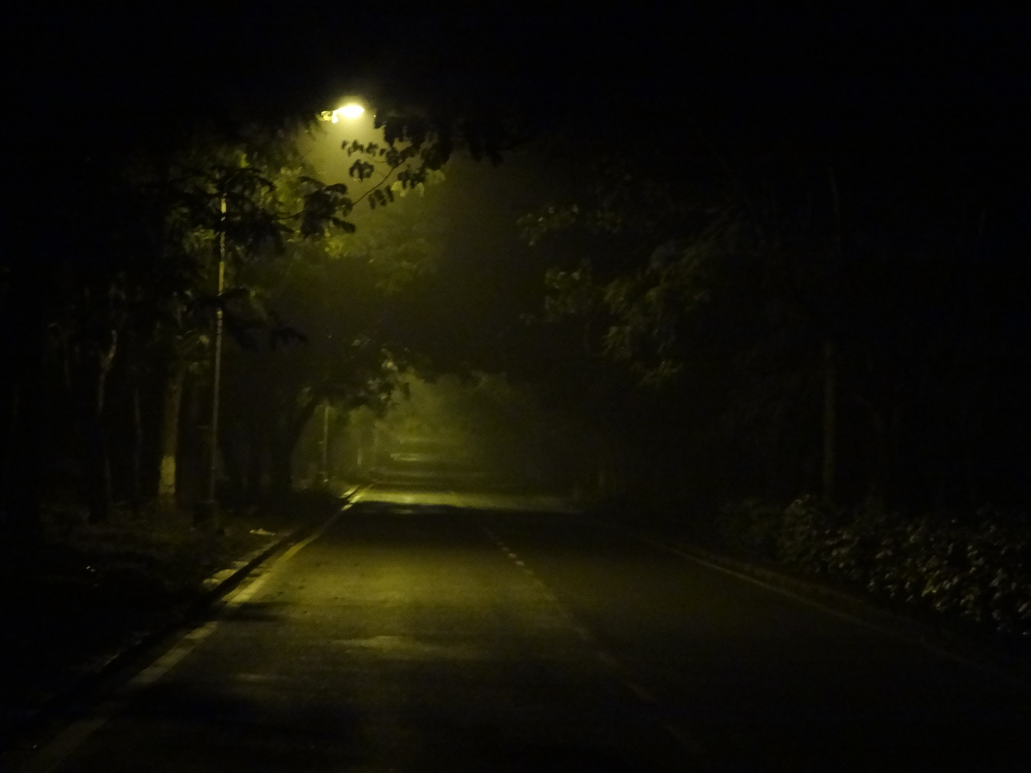
Who is Clive Barker
He’s an english writer, who wrote comic books, novels, short stories, movies, and plays.
He’s a film director, who directed films that manifested from literature that he wrote.
He is also a prolific visual artist, who often illustrated his own books.

Slide 6
Who is Clive Barker Cont.
He attended Dovedale Primary School, on Herondale road in the Mossley Hill district of Liverpool, United Kingdom.
He went on to Quarry Bank High School, on Harthill Road in the Liverpool Suburb of Allerton, United Kingdom.
He also attended the University of Liverpool, where he majored in English and philosophy.

Slide 7
Who and what influenced him
The informal interactions he had with actors influenced his interest in theatre.
Him witnessing a man fall to his death, influenced his fascination with morbid, forbidden sights that inspired him to become a visual artist.
As a teen, Barker became an enthusiastic reader of horror fiction, particularly the work of Edgar Allen Poe, which is who influenced his creative work in the horror genre.

Slide 8

His writing style
“I feel that horror literature is touching upon the big issues time and time again. Death and life after death, sex after death, insanity, loneliness, anxiety. Horror writers are addressing the deepest concerns of the human condition”
---Clive Barker
https://youtu.be/hphykQqVqKo

Slide 9
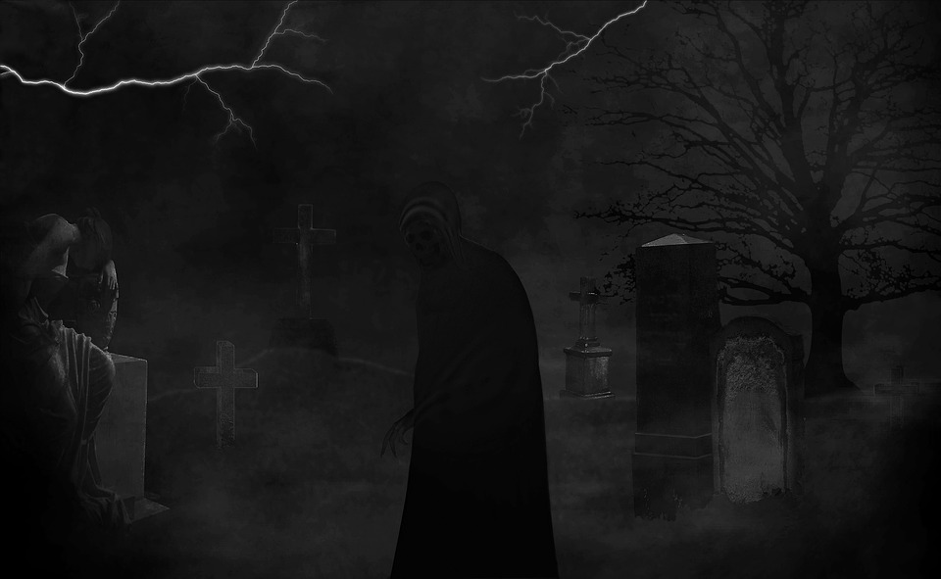
Influences Cont.
Herman Melville, who was an american novelist, short story writer,and poet.
Ray Bradbury, who was an American author and screenwriter.
William S. Burroughs, who was an American writer and visual artist.
William Blake, who was an English poet, painter, and printmaker.
Jean Cocteau, who was a French poet, writer, designer, playwright, artist, and filmmaker.

Slide 10
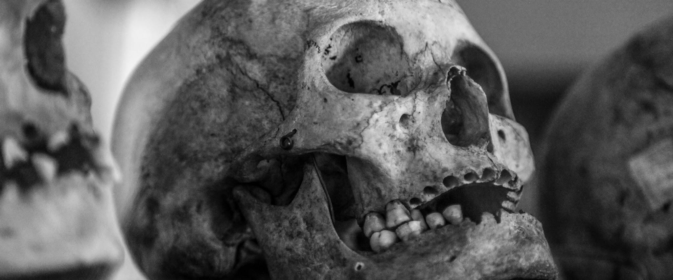
His work
He published his fiction work for the first time, in the form of a short-story collection titled “Clive Barker’s Books of Blood” in 1984. This collection became an instant best seller.
He published his first novel titled, “The Damnation Game” in 1985.
He then went on to publish three more Books of Blood, and two additional novels Weaveworld and Cabal, published in 1987.

Slide 11
Directed by Clive Barker
Hellraiser (1987)
Nightbreed (1990)
Lord Of Illusions (1995)
Salome (1973)
The Forbidden (1978)
Motorhead- Hellraiser (1992)
Nightbreed - Directors Cut (2014)

Slide 12

The Books of Blood Volume#1
The Book of Blood
The midnight Meat Train
The Yattering and Jack
Pig Blood Blues
Sex, Death, and Starshine
In the Hills, the Cities.

Slide 13
The Yattering and Jack
He wanted confrontation with the old one’s emissary once and for all. Without warning the tree gave way to dictates of centrifugal force, and exploded. The noise was like a howl of death. Branches, twigs, needles, balls, lights, wire, ribbons, flew across the room. Jack, his back to the explosion, felt a gust of energy hit him hard, and he was flung to the ground. The back of his neck and his scalp were shot full of pine-needles. A branch, naked of greenery, shot past his head and impaled the sofa. Fragments of tree spattered to the carpet around him.
What was happening to Jack?

Slide 14
The Yattering and Jack
Now other objects around the room, spun beyond the tolerance of their structures, were exploding like the tree. The television blew up, sending the lethal wave of glass across the room, much of which buried itself in the opposite wall. Fragments of the television innards, so hot they signed the skin, fell on jack, as he elbowed himself towards the door like a soldier under bombardment. The room was so thick with a barrage of shards it was like a fog.
Gina was crouching at the door, urging him to hurry, her eyes narrowed against the hail. As jack reached the door, and felt her arms around him, he swore he could hear laughter from the Lounge.
Tangible audible laughter, rich and satisfied
Where was the tangible audible laughter, that was rich and satisfied coming from? And why?

Slide 15
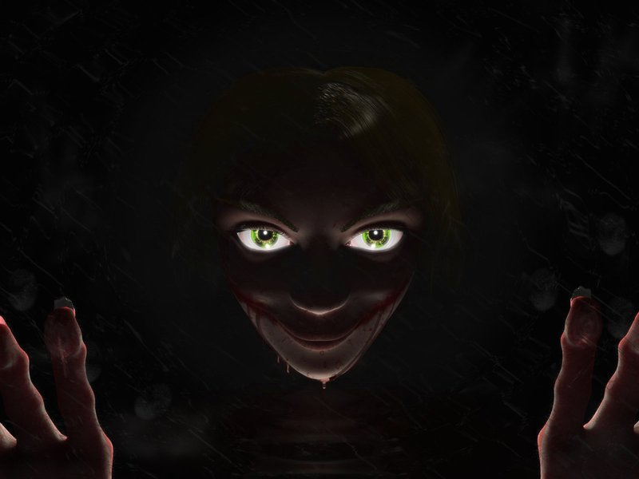
By, Dallie Shell

