Slide 1

Homelessness Social Issue Presentation
By DALLIE Shell
Rutgers university-newark

Slide 2
Homelessness as a
Social Issue in New Jersey
Point in time is a statewide initiative geared towards making society aware of the issue by recording data that identifies the scope of the problem on any given night. Homelessness in the state of New Jersey is influenced by the progressively rising cost of living, biased social policies, poverty, and unaddressed mental health & substance use issues. A lack of affordable housing, and service gaps that trap individuals and families who would necessarily qualify for social resources that could change the quality of their lives. Homelessness in New Jersey adversely impacts families, youths, veterans, and older adults across the tri-state area.
In New Jersey
12,680
People were experiencing homelessness on 1 night in 2024
In New Jersey
1,737
People were unsheltered during the point time count
In New Jersey
4,568
people in the point in time count represented families, and children
In New Jersey
17,315
People represented students experiencing homelessness between 2023-2024

Slide 3
What makes Homelessness a major social issue?
Homelessness Defined
Why Homelessness Matters
What this information reflects for the State Of New Jersey
Anyone who do not have access to permanent housing that is safe, secure, and zoned for human habitation including
Emergency Shelter
Transitional Housing
Encampment Communities
Abandoned Dilapidated Houses
Train Stations
Cars, Parks, and Air ports
Homelessness matters because it has an adverse impact on social value by promoting poor mental and physical health. (Lachaud et al., 2024)
Homelessness matters because it legitimizes the need for state and local governments to increase affordable housing opportunities. (Horton, 2023)
Homelessness matters because it adversely impacts vulnerable populations who are generational victims of structural violence. (Murray et al., 2026)
The cost of living, high housing costs, and lack of affordable housing resources contribute to housing scarcity.
The State of New Jersey homelessness data includes a variety of groups that include families, youths, domestic violence survivors, veterans, and older adults.
Therefore, to address these challenges, the communities in the State of New Jersey need housing interventions that include rapid re-housing, housing choice vouchers/section 8, and other affordable housing resources to combat the cost of being a renter.

Slide 4
Homelessness in New Jersey by the Numbers.
According to the National Alliance to End Homelessness, there was a “26.4% increase in homelessness from 2015 to 2024”. The State of New Jersey documented homelessness data shows both the magnitude of homelessness and the mounting pressures being projected onto housing systems. Data from the State of New Jersey shows that in 2024, 19,086 individuals and families entered the homelessness process, and only 6,069 were permanently housed. (DiFilippo, 2024). This information suggests that the inflow of residents and families into homelessness was larger than the number of people who obtained affordable permanent housing. (Homelessness in New Jersey- by the Numbers, 2024) Therefore, confirming that the need for affordable housing resources in New Jersey requires more than an emergency response to address homelessness. (Is Affordable Housing Finally Gaining Ground in New Jersey?, 2025)
There was 12,680
Total people experiencing homelessness in New Jersey’s 2024 Point-In-Time count.
86%
of New Jerseys overall homeless population represents individuals and families that was sheltered.
14%
of New Jersey’s homeless population represents individuals and families that was unsheltered.
16.6%
of New Jersey’s homeless population represents individuals and families that are chronically homeless.
35.8% of New Jerseys homeless population represented individuals and families with children

Slide 5
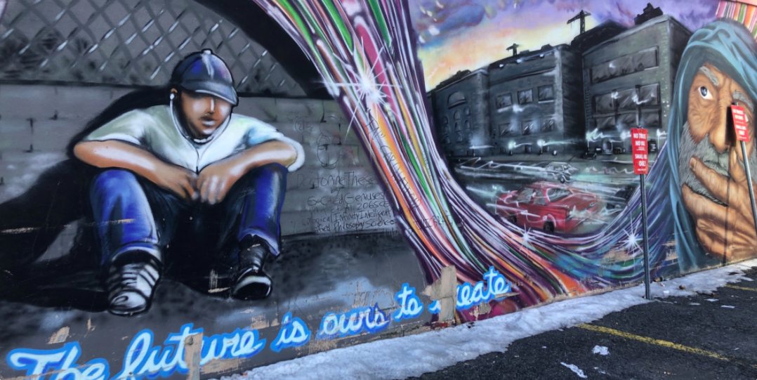
Key Factors that influence homelessness
Cost of living
Socioeconomic
The rising cost of living in New Jersey is a key factor that influences homelessness.
According to the US consensus, to afford a two-bedroom apartment, a family needs to earn $39.99 an hour for a modest housing arrangement. (Housing Crisis vs Wage Crisis - NLIHC Out of Reach Report - High Cost of Housing, 2021)
Therefore, the rising housing costs, limited low-income housing, and economically unstable individuals and families are structurally thrust into homelessness.
Job loss, Unstable earning opportunities, and Eviction
Domestic Violence, Family Conflict, and Trauma
Lack of identification documents and barriers to social service resources.
Substance Use, Discharge from hospitals and institutions without housing.
Mental Health issues without access to treatment.

Slide 6

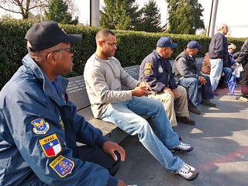
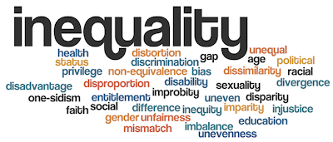
Who is impacted by Homelessness
Children, Youth, and Families
Vulnerable Adults
Racial Disparity
4,568 of the people counted during Point-In-Time represented families with children.
54% represented school age girls, and women.
55% Identified as African American
2,689 of the people counted during Point-In-Time represented the elderly population experiencing homelessness age 55 and older.
1,466 represented domestic violence survivors.
518 to 521 represented veterans.
The State of New Jersey Point-In-Time reported that the African American population is represented in homelessness more than any other nationality.
43% reported substance abuse issues.
The Point-In-Time report emphasized the need to establish efforts to address the racial disparities in homelessness services.

Slide 7
Biopsychosocial Issues Influenced by Homelessness
Family & Education
Individual Health Risks
Systems in the Community
Absenteeism in school and work.
Adverse mental growth and development
Higher stress, abandonment, child abuse, and neglect.
Barrier to employment, transportation, and fundamental learning.
Enhanced family dependence on social welfare resources.
Lack of emergency shelter resources.
Overwhelmed hospitals
Increased pressure on law enforcement.
Increased number of disengaged students in school districts.
Higher community crisis response costs.
Increased strain on housing markets.
Higher volume of homeless families with unmet needs.
Chronic illness
Trauma
Substance use
Untreated mental health dysfunction.
Increased exposure to violence and crime.
Enhanced medical emergencies with worsening health outcomes

Slide 8
Current Housing & Homelessness Response in New Jersey
Department Of Community Affairs
Office Of Homeless Prevention
NJ Department of
Education
The Department of Community Affairs has increased support for individuals and families experiencing homelessness or on the cusp of becoming homeless by offering residents of New Jersey resources to prevent homelessness.
HPP (Housing Prevention Program) provides rental and utility assistance to at-risk individuals and families.
Section 8 is an affordable housing program that ensures low-income families have equitable, safe, and secure housing.
In New Jersey, the Office of Homeless Prevention facilitates the HPRP2-Homeless Prevention and Rapid Rehousing Program, is an eviction-based program that services individuals and families who are at risk of eviction or are in need of rapid rehousing services.
The New Jersey Department of Education's McKinney-Vento initiative assists students experiencing homelessness.
The goal of this agency is to support students through school-based services to help them navigate homelessness and education.

Slide 9
Recommendations to spearhead homelessness
Extremely Low Income- Develop housing options geared towards extremely low-income individuals and families.
Rental Assistance - Expand eligibility criteria for individuals and families with higher-than-low incomes who still need rental assistance to sustain permanent housing.
Homeless prevention- Allocate more funding to support eviction prevention, legal help, and benefits for families before shelter placement.
Target Disparities- Utilize the state's housing and homelessness data to formulate an intervention that focuses on racial disparities, youth, adults, and communities with long-term needs.
School and student housing- Incorporate housing, education, health, and workforce resources to prevent needy families and students from falling through the gaps.

Slide 10
References
Murray, T. A., Breakey, S., Coleman, C. L., Gomes, M. G., Nguyen-Truong, C., Connor, A. L. & Angosta, A. D. (2026). Structural violence, population health, and health equity. Nursing Outlook 74(2). https://doi.org/10.1016/j.outlook.2026.102691
Horton, J. (February 6, 2023). State Approaches to Address Homelessness and Increase Affordable Housing. The Council of State Governments. https://www.csg.org/2023/02/07/state-approaches-to-address-homelessness-and-increase-affordable-housing/
Lachaud, J., Yusuf, A. A., Maelzer, F., Perri, M., Gogosis, E., Ziegler, C., Mejia-Lancheros, C. & Hwang, S. W. (2024). Social isolation and loneliness among people living with experience of homelessness: a scoping review. BMC Public Health 24. https://doi.org/10.1186/s12889-024-19850-7
2025-2029 Consolidated Plan and 2025 Annual Plan Public. https://www.nj.gov/dca/dhcr/offices/pdf/2025-2029Consolidated_Plan-and-2025Annual-Plan-Public.pdf
DiFilippo, D. (October 21, 2024). Homelessness continues climbing in New Jersey, new annual count shows. New Jersey Monitor. https://newjerseymonitor.com/2024/10/22/homelessness-continues-climbing-in-new-jersey-new-annual-count-shows/
(January 23, 2024). Homelessness in New Jersey- by the Numbers. NJ 2-1-1 Partnership. https://nj211.org/homeless-in-new-jersey-by-the-numbers
(August 21, 2025). Is Affordable Housing Finally Gaining Ground in New Jersey?. Shelterforce. https://shelterforce.org/2025/08/22/fifty-years-after-mount-laurel-is-affordable-housing-finally-gaining-ground-in-new-jersey/
Out of Reach New Jersey 2025. https://nlihc.org/sites/default/files/oor/2025_OOR-New-Jersey.pdf
(November 12, 2023). New Jersey Department of Community Affairs | DCA’s Office of Homelessness Prevention Announces Significant Progress in Reducing and Preventing Homelessness. New Jersey Department of Community Affairs. https://www.nj.gov/dca/news/news/2023/20231113.shtml
(July 27, 2021). Housing Crisis vs Wage Crisis - NLIHC Out of Reach Report - High Cost of Housing. New Jersey Housing and Mortgage Finance Agency. https://www.nj.gov/dca/hmfa/about/pressreleases/2021/20210728.shtml

Slide 11
References Cont.
Monarch Housing Associates. (2024). New Jersey 2024 Point-in-Time Count.
National Alliance to End Homelessness. (2025). New Jersey fact sheet using 2024 HUD Point-in-Time data.
National Low Income Housing Coalition. (2025). Out of Reach: New Jersey.
National Low Income Housing Coalition. (2026). New Jersey Housing Profile / housing needs by state.
New Jersey Department of Community Affairs. Housing Assistance and Office of Homelessness Prevention pages.
New Jersey Department of Education. McKinney-Vento Education for Homeless Children and Youth Program.
New Jersey Department of Education. Statewide homeless student counts by county, 2023-2024.
U.S. Department of Housing and Urban Development. 2024 Annual Homelessness Assessment Report (AHAR) Part 1.

Slide 12
Discussion Question
Do you think New Jersey should allocate more resources for emergency shelter and crisis response to homelessness, or into long-term affordable housing and homelessness prevention? Why?

